Slide 1


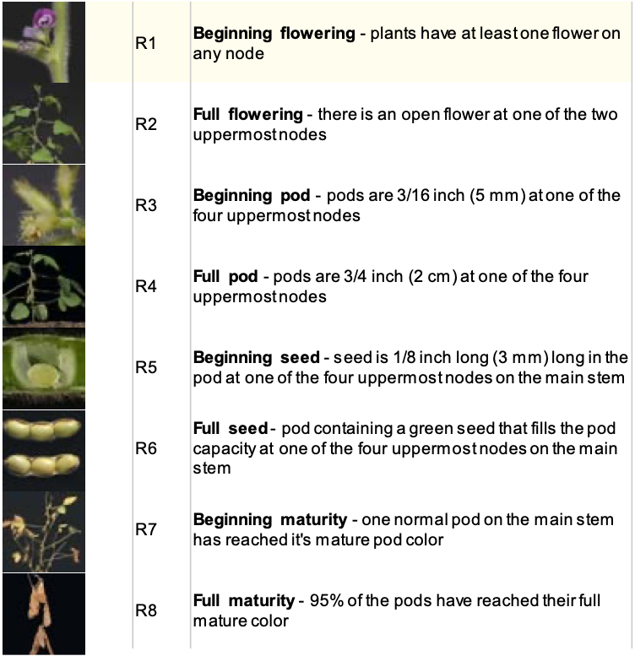
Transcriptome Analysis To Increase Oil Yield In Soybeans
Pranav Palli, Chi Zhang
School of Biological Sciences, Manter Hall, University of Nebraska-Lincoln, Lincoln, NE, 68588-0118
ABSTRACT
Plants extract carbon dioxide (CO₂) from the atmosphere to synthesize carbohydrates, proteins, and lipids. These so-called “carbon-capture pathways” effect the seed composition and yield of plants as they grow. In soybeans, possessing an efficient carbon capture pathway during seed development can increase the yield and redirecting flux to fatty acids can increase the oil content in soybean seeds by more than 20%. While the link between the pathway and yield/oil content is known to exist, the effect of carbon capture/partitioning pathway regulation onto the corresponding phenotypes is poorly understood in transgenic soybeans. Therefore, uncovering the intricate interactions among the genes involved in carbon capture and partitioning pathways is important to generating optimally-transgenic soybeans for seed development to further increase the yield and oil content.
EXPERIMENT
To conduct the mass systems-based analysis of various plant lines, 4 types of plants with 3 replicates each were planted in a field. The types and their gene combination is as shown in Table 1. (Note- WR1 is a transcription factor protein that is crucial for oil accumulation hence it is tested alone and with the other genes). Each of these plants were tested over distinct time periods as outlined below. There are three time-periods- R5, R5/6 (5.5), and R6 which are part of many more as shown in Figure 1. Figure 1. Stages of growth Since there are 4 plant types, each with 3 replicas where data is measured 3 times, there are 36 samples being taken. The samples are represented in the following way: The letters A, B, & C represent a plant in R5, R5/6, & R6 respectively The numbers 1, 2, 3, & 4 represent a WT, WR1, WR1 + DGAT, & WR1 + KASII plants For example, a sample that is from a WT plant at R5 would be A1_x where ‘x’ is the replica– 1, 2, 3 while a sample that is from a WR1 + DGAT plant at R6 would be C3_x. <HOW THE DATA WAS COLLECTED>
Submitting Posters
The Pixel Lab will not print PowerPoint files. You must convert your PowerPoint file (PPT) to a PDF file before you submit it to print. Here’s how to convert your file: Click the File tab. Click Save As. Enter a name for the file in the Save As box, if you haven’t already. Select a file destination on your computer or flash drive. Under the File Format type box, select PDF. Click Save. Once you’ve converted your poster you can submit it to print one of three ways. Here’s how submit your file: Send your PDF poster file via email to pixel-lab@unl.edu. For larger PDF files, upload to our website at pixel-lab.unl.edu, and send us an email that includes all of your information. Bring your PDF file in person on a flash drive to the Pixel Lab in 123 Henzlik Hall, located on the north side of Vine street between 14th and 16th streets.
INTRODUCTION
Since carbon capture pathways are extremely important to plants, lots of research has been conducted leading to the improvement in our understanding specifically of pathways that lead to fatty acid production. Through this research, we have isolated three specific genes/proteins that can increase oil content in soybean seeds have been chosen– DGAT1, KASII, WR1. These genes were combined into multiple samples of soybean plants that were planted and allowed to grow. Phenotyping data for these plants such as oil content/size of seeds is being measured. While this progress is great, several questions still are yet to be addressed– specifically those relating to what kinds of interactions and coordination among key genes exist in each pathway and/or between different pathways. One promising method to investigate these relationships is applying a systems approach to analyze transcriptomic sequencing data for variant transgenic lines carrying different functional genes. This shows different patterns of expression between different development stages and/or between different transgenic lines. Therefore, this project will explore the differentially expressed genes in several transgenic soybean lines and identify the linkage between gene expression patterns and phenotyping results.
RESULTS
Follow these helpful pointers for your graphics... Images copied from the web are low resolution (72 dpi) images and are not good quality for print. Images must be at least 150 dpi to ensure their ability to print. All graphics should be pictures inserted directly into PowerPoint using the insert Picture from file option. The preferred image format for all inserted images is JPEG. TIF files will also work. (tif files have transparent backgrounds and jpg files do not.) Avoid png and gif files. Do not enlarge images after they have been inserted into PowerPoint. They will lose quality and become pixelated. To scale an image and retain its proportion, hold down the shift key on your keyboard and click and drag with your mouse on one of the corners. If you have graphs or charts from Excel that need to be included in your poster, simply copy in Excel and paste into PowerPoint. You can bring in graphs and charts from Word by choosing Insert>Object… and choosing Microsoft Word Document. This will maintain the quality of your document and keep the background transparent.
ACKNOWLEDGMENTS
Love, M.I., Huber, W., Anders, S. Moderated estimation of fold change and dispersion for RNA-seq data with DESeq2. Genome Biology 15(12):550 (2014) Hadley Wickham, Romain François, Lionel Henry and Kirill Müller (2021). dplyr: A Grammar of Data Manipulation. R package version 1.0.7. https://CRAN.R-project.org/package=dplyr This work was supported by the Nebraska Public Power District through the Nebraska Center for Energy Sciences Research at the University of Nebraska-Lincoln. This poster template was taken from the free online templates offered by The Pixel Lab at the University of Nebraska-Lincoln.
# | Line | Plot | Plasmid/genes
1 | Thorne | 9 | Wild type (WT)
2 | 917-17 | 5 | pPTN1174 (WR1)
3 | 970-1 | 15 | pPTN1248 (WR1+DGAT)
4 | 1053-10 | 2 | pPTN1314 (WR1 + KasII)
Table 1. Plant types in Experiment

